Slide 1
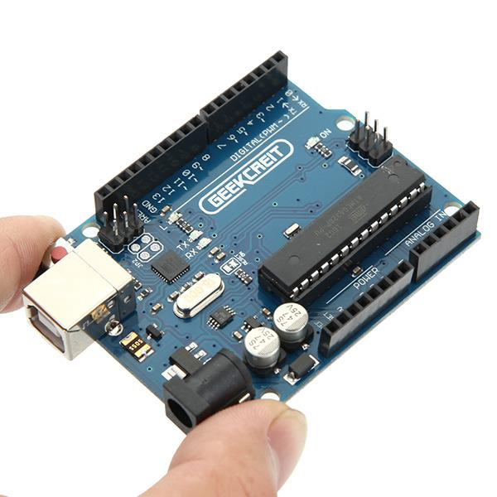
An Introduction the Arduino
Peter Beens,
CEMC 2016
@pbeens
URL for this presentation: https://goo.gl/EPz1uh
Image courtesy of http://goo.gl/8nJroG

Slide 2
“Arduino” refers to an open-source electronics platform or board and the software used to program it.
Credit(s): https://www.techopedia.com/definition/27874/arduino

Slide 3
A pre-assembled Arduino board includes a microcontroller
Programmed using Arduino programming language (a simplified form of C/C++) and the Arduino IDE, available at https://www.arduino.cc
Provides a way to build and program electronic circuits, thereby learning CS and electronics
Arduino programs are called "sketches"
Credit: https://en.wikipedia.org/wiki/Arduino

Slide 4
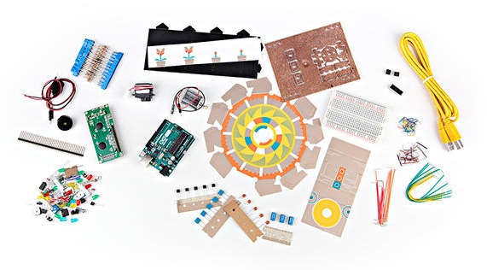
Main Inspiration:
http://labs.arduino.org/Arduino%20Starter%20Kit

Slide 5
Intro Videos

Slide 6
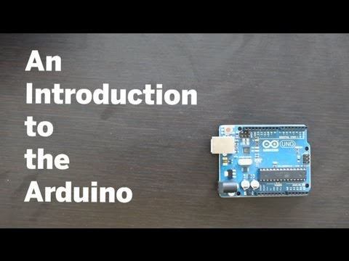
An Introduction to the Arduino (from Make Magazine) (4:25)
https://www.youtube.com/watch?v=CqrQmQqpHXc

Slide 7
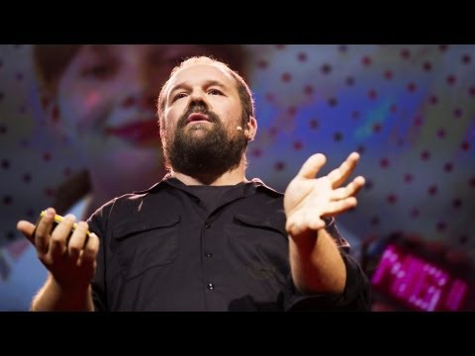
Massimo Banzi: How Arduino is open-sourcing imagination (15:46)
https://www.youtube.com/watch?v=UoBUXOOdLXY

Slide 8

“Tutorial 01 for Arduino: Getting Acquainted with Arduino” (14:31)
https://www.youtube.com/watch?v=fCxzA9_kg6s

Slide 9
Our First Program!

Slide 10
“Empty Program”
This program will allow you to:
See the basic functions of an Arduino program
Learn how to configure the editor (IDE) for the Arduino
Learn how to check the syntax of a program
Learn how to upload the program into the Arduino

Slide 11
Save as “Empty”
void setup() {
}
void loop() {
}
Note!
Save the code for all your programs in a folder named “Arduino” in your home folder.

Slide 12
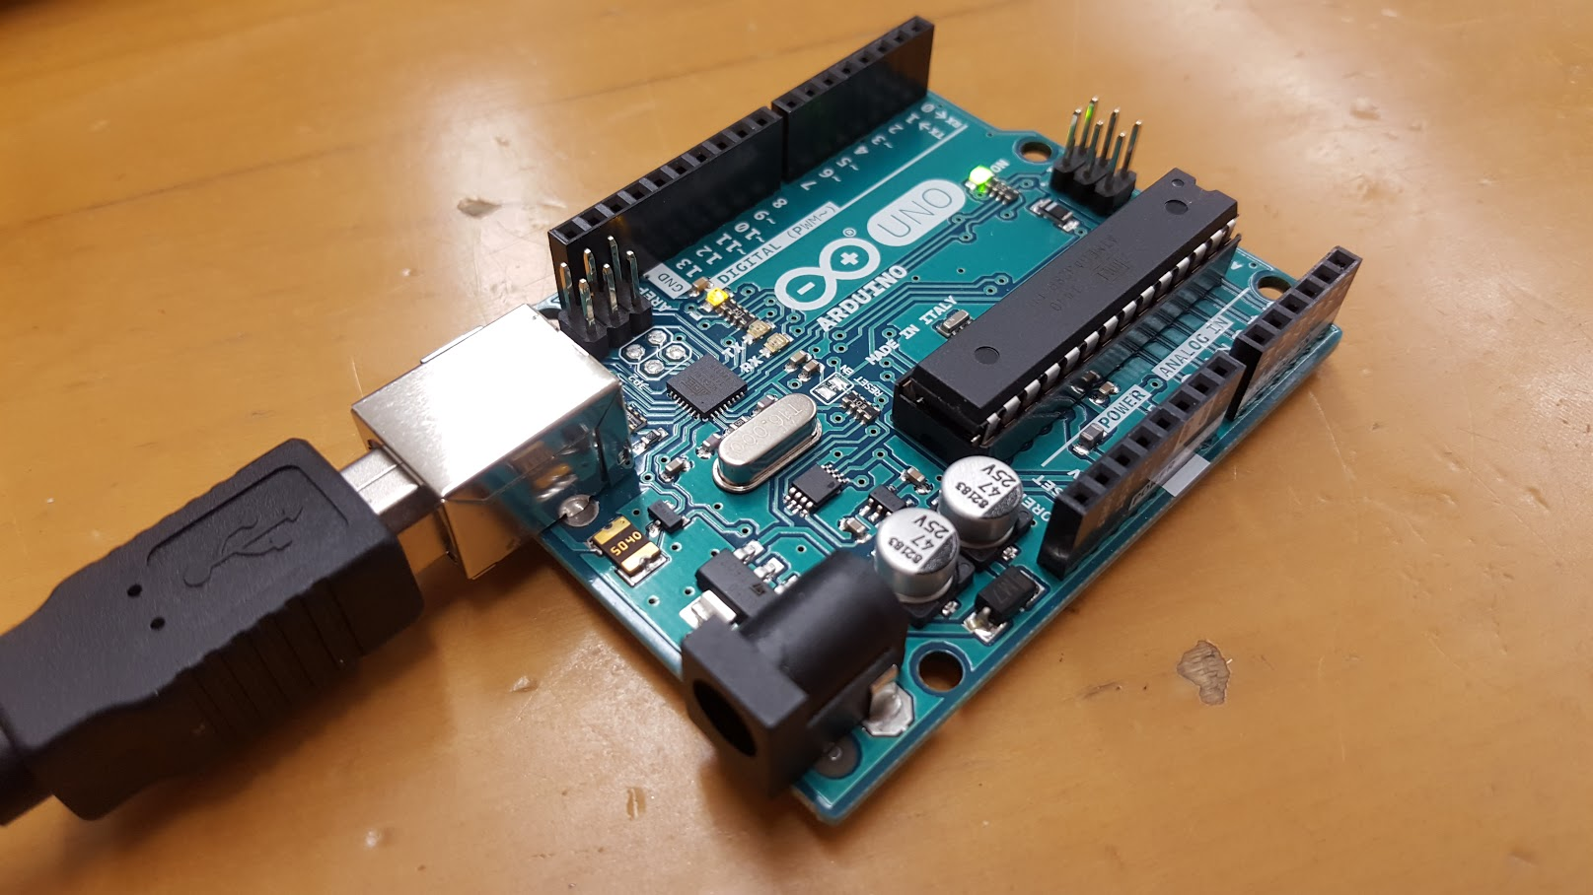
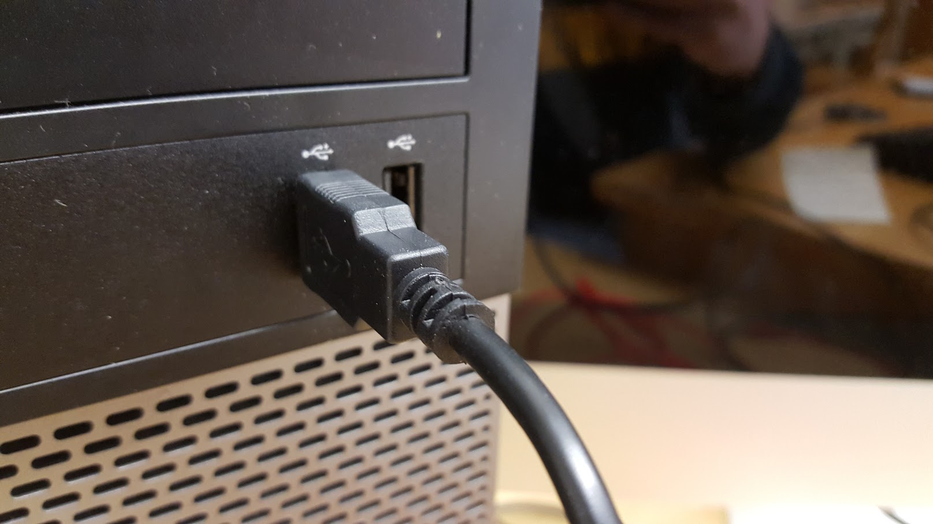
Connect Your Arduino...

Slide 13
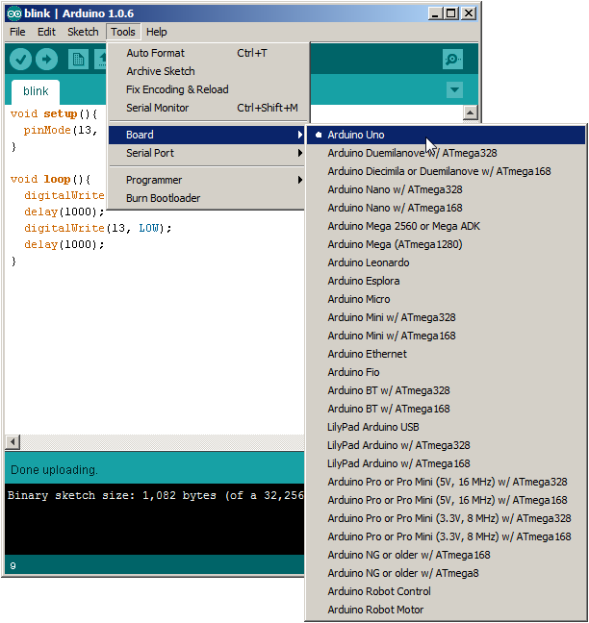
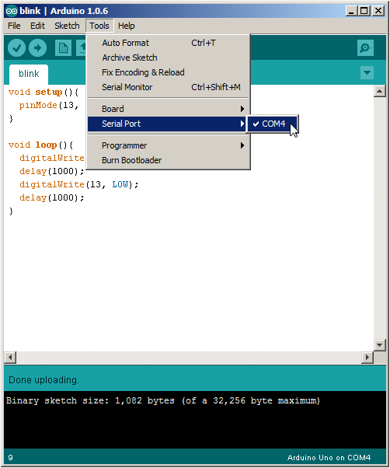
Before Uploading...

Slide 14
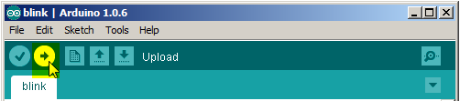
Upload!
Watch the LEDs on the Arduino while the program is uploading...

Slide 15
Program #2: “Blink”

Slide 16
“Blink”
This program turns on an LED on for one second, then off for one second, repeatedly.
Most Arduinos have an on-board LED you can control. On the Uno and Leonardo, it is attached to digital pin 13.
Credit(s): http://labs.arduino.org/STARTER+KIT+-+GET+TO+KNOW+YOUR+TOOLS

Slide 17
Save as “Blink”
// the setup function runs once when you press reset or power the board
void setup() {
// initialize digital pin 13 as an output.
pinMode(13, OUTPUT);
}
// the loop function runs over and over again
void loop() {
digitalWrite(13, HIGH); // turn the LED on
delay(1000); // wait for a second
digitalWrite(13, LOW); // turn the LED off
delay(1000); // wait for a second
}
Note!
The highlighted comments are not necessary for your program, but it’s good programming practice for you to include lots of them to help document your program.
Credit(s): http://labs.arduino.org/STARTER+KIT+-+GET+TO+KNOW+YOUR+TOOLS

Slide 18
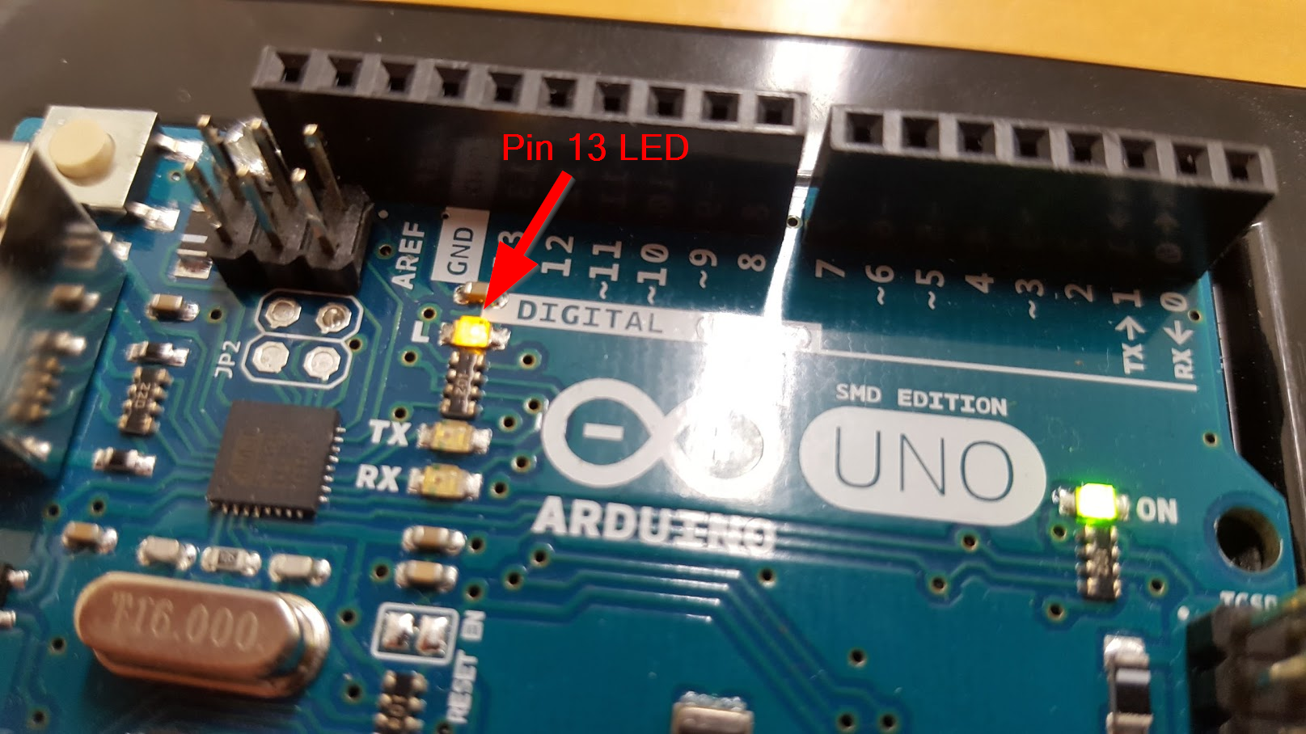
Did it Work?!!

Slide 19
Some Arduino Programming Basics

Slide 20
Note!
The #1 rule in programming is:
Save Early, Save Often!

Slide 21
Variables
A variable is a place for storing a piece of data. It has a name, a type, and a value.
Example:
Credit(s): http://labs.arduino.org/What+is+a+Sketch

Slide 22
Variables (cont’d)
This example declares a variable with the name ledPin, the type int, and an initial value of 13.
It's being used to indicate which Arduino pin the LED is connected to.
Every time the variable “ledPin” appears in the code, its value will be retrieved (i.e. the value 13).
Credit(s): http://labs.arduino.org/What+is+a+Sketch

Slide 23
Program #3: Blink with a Variable

Slide 24
Task:
Modify your Blink program by inserting the ledPin declaration (as shown in the previous slide) and substituting “13” with “ledPin” everywhere in your program.
The declaration line should go above the setup() function.
Don’t forget to save your program!

Slide 25
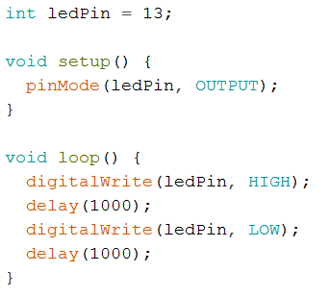
Your code should look like this:

Slide 26
Let’s Hook Up an External LED!

Slide 27
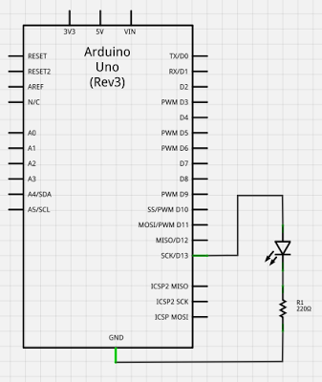
Schematic
The resistor is needed to protect the LED. It limits the current to a safe amount and drops the voltage across the LED to about 2 volts.
Image source: http://www2.beens.org/computer-technology/arduino/activities/blinking-led

Slide 28
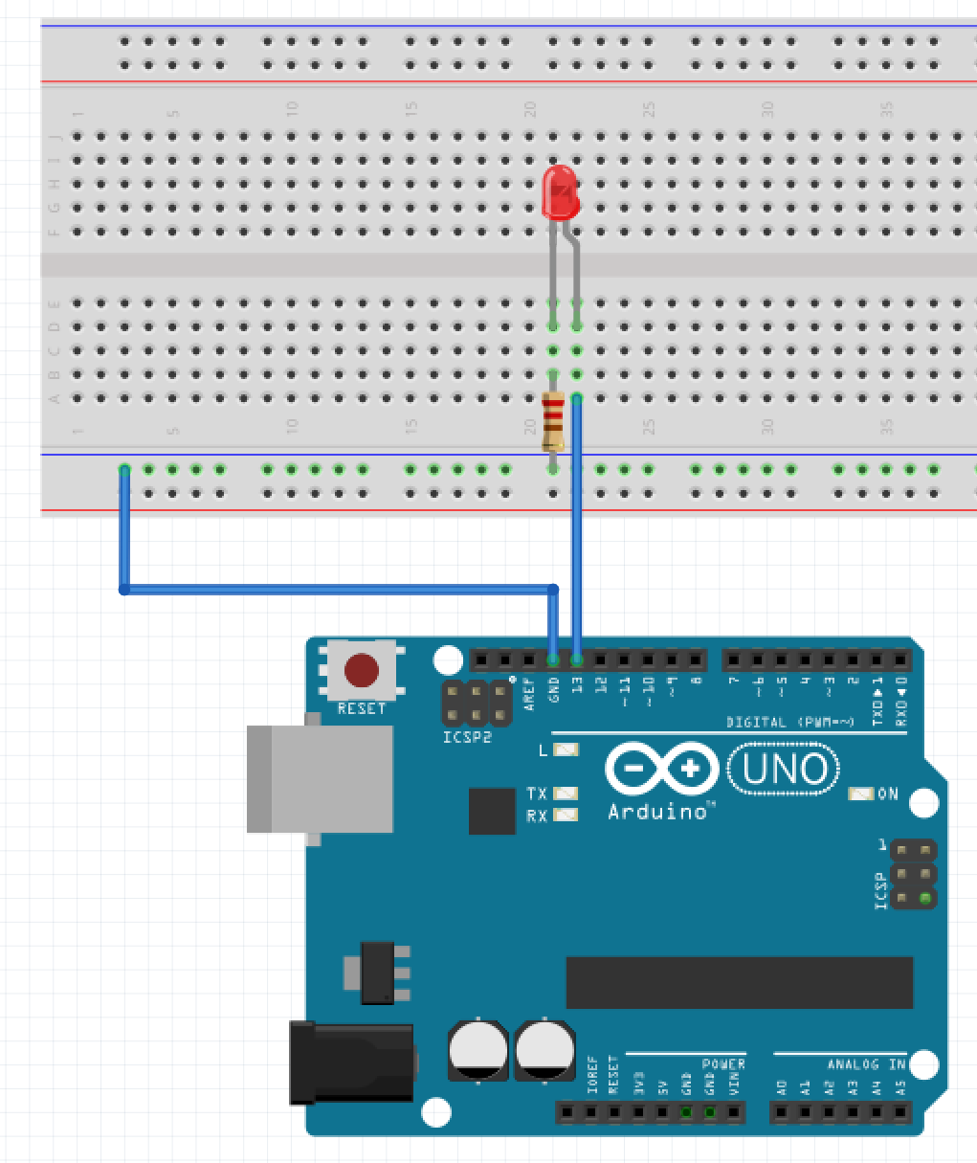
Pictorial
Note!
Unplug your Arduino while hooking up the electronic components. Get the circuit checked before applying power.
Image source: http://www2.beens.org/computer-technology/arduino/activities/blinking-led

Slide 29
Program #4: A Traffic Light

Slide 30
Let’s Build a Traffic Light!
Save your Blink program as “TrafficLight”.
Modify “ledPin” to be “redLED” throughout your program.
Add two variables “yellowLED” and “greenLED”, using pins 12 and 11, respectively.
Modify your program and your circuitry to simulate a traffic light!

Slide 31
Program #5, 6, and 7: 8 LEDs

Slide 32
8 LED Circuit and Programs
First, wire up 8 LEDs. Remember that each LED requires its own resistor. For convenience, use pins 6-13. (Hint: use pin 6 for LED 1, 7 for LED 2, etc.)
Program 5: Simply flash all 8 LEDs on and off.
Program 6: Light the LEDs in sequence.
Program 7: Create a binary counter, with each LED representing one bit in a byte.

Slide 33
Supplemental Material

Slide 34
Fritzing
“Fritzing is an open-source hardware initiative that makes electronics accessible as a creative material for anyone. We offer a software tool, a community website and services in the spirit of Processing and Arduino, fostering a creative ecosystem that allows users to document their prototypes, share them with others, teach electronics in a classroom, and layout and manufacture professional PCBs.”
http://fritzing.org

Slide 35
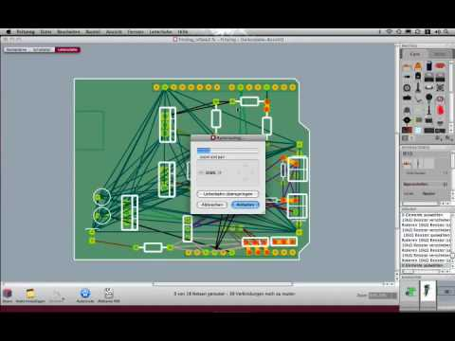
Fritzing cont’d

Slide 36
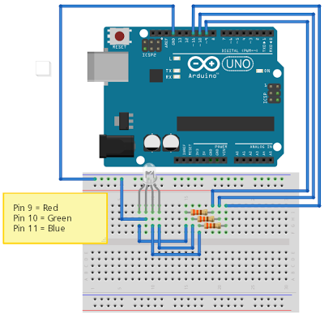
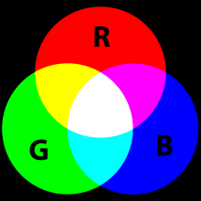
From a Traffic Light to RGB!
Assignment
Write a program that loops through the following colours, with each colour being displayed for 500 mS:
green
yellow
red
magenta
blue
cyan
white
Frtizing diagram source: http://www2.beens.org/computer-technology/arduino/activities/rgb-leds
RGB image source: http://upload.wikimedia.org/wikipedia/commons/thumb/c/c2/AdditiveColor.svg/220px-AdditiveColor.svg.png

Slide 37
Further Exploration:
Electronics and Arduino simulator https://circuits.io/
Arduino Tutorials http://www.arduino.org (Learning tab)
Arduino Reference https://www.arduino.cc/en/Reference

Slide 38
Parts list for the kits we used:
https://goo.gl/yMOjJT

Slide 39
My Electronics Presentation
https://goo.gl/fA49Yc

Slide 40
Thanks!
Followup questions or comments? Email me at pbeens@gmail.com.

